Slide 1
Modern Publishing Tools for Modern Science
An open-source web app of the 2021 Nutrient Requirements of Dairy Cattle Dave J. Innes, Braeden G. Fieguth & John P. Cant

Slide 3
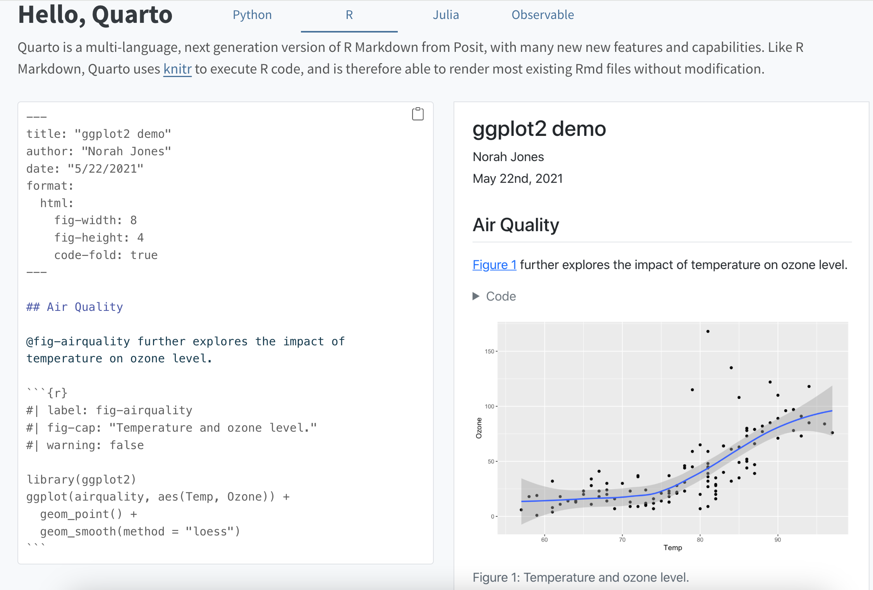
Intro to Quarto
Unified authoring framework
Flat text files (based on Pandoc markdown)
Easy to read and write
Can also execute code directly (supports R, Python, Julia, Observable)
Encourages reproducible analysis

Slide 4
Category | Formats
Documents | HTML, PDF, MS Word, OpenOffice, ePub
Presentations | Reveal.js, PowerPoint, Beamer
Markdown | GitHub, CommonMark, Hugo, Docusaurus
Wikis | MediaWiki, DokuWiki, ZimWiki, Jira Wiki, XWiki
More | JATS, Jupyter, ConTeXt, RTF, reST, AsciiDoc, Org-Mode, Muse, Texinfo, Groff Man Page, Groff Manuscript, Haddock, OPML, Textile, DocBook, InDesign, TEI Simple, FictionBook
Render to many formats

Slide 5
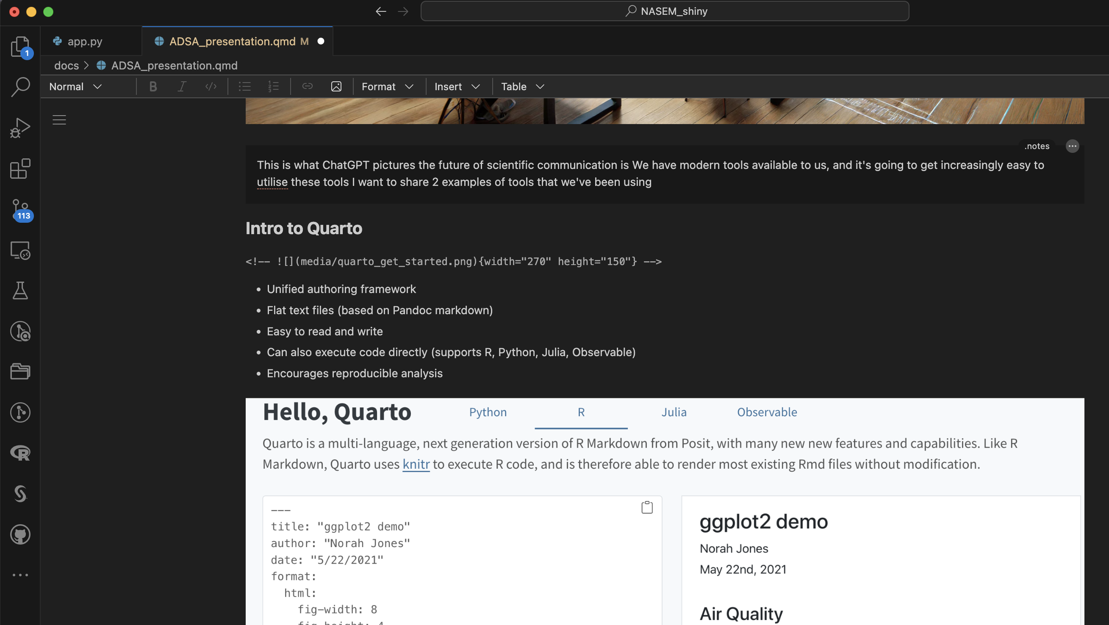
The source code of this presentation
Visual editor for a .qmd file

Slide 6
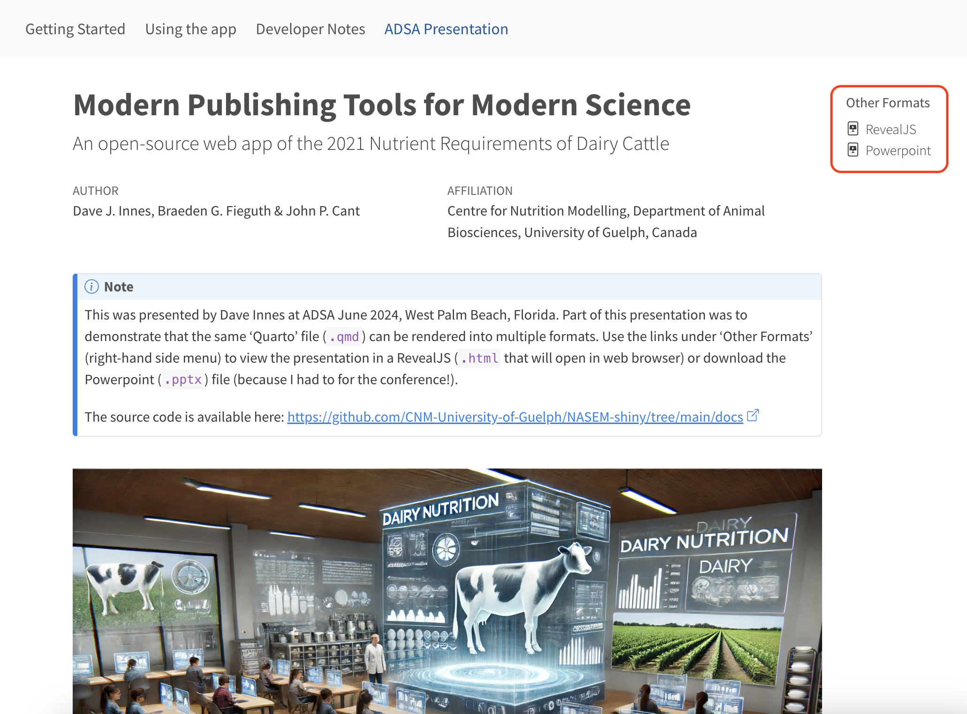
Rendered to multiple formats

Slide 7
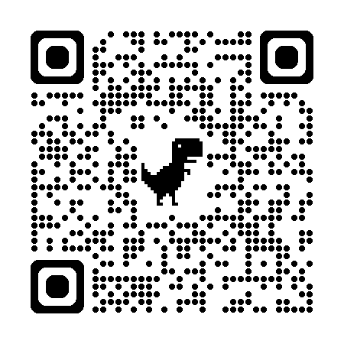
View this presentation in other formats:
https://cnm-university-of-guelph.github.io/NASEM-shiny/ADSA_presentation.html

Slide 8
Interactivity

Slide 9
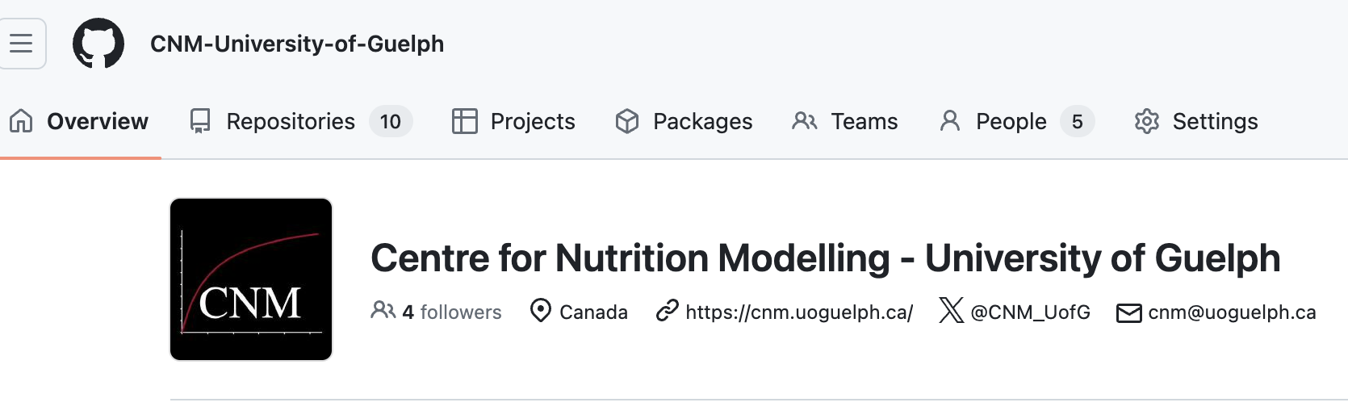
Why develop a Shiny version of NASEM 2021 Model?
NASEM in Python
Thanks to Braeden Fieguth!
Open-source, tracked and collaborative
https://github.com/CNM-University-of-Guelph

Slide 10
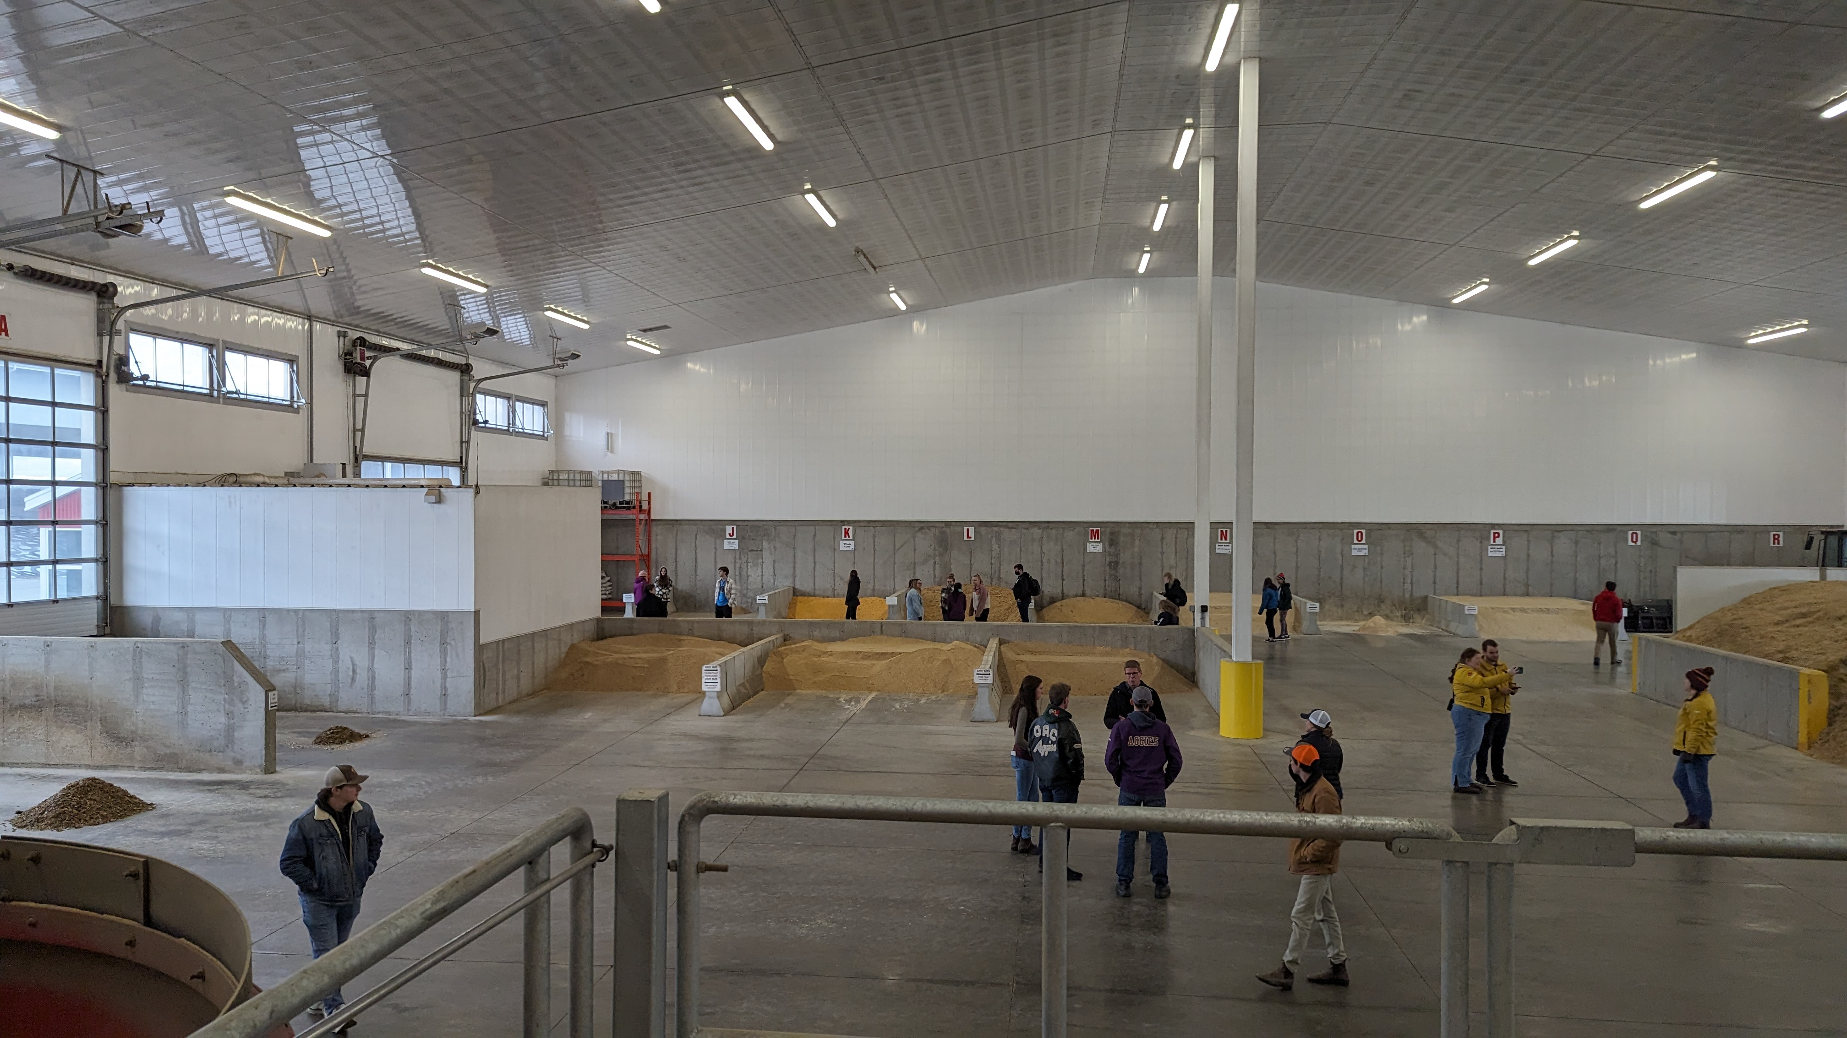
Fourth year Dairy Cattle Nutrition class
45 undergraduate students
Mixed background: ~20% had dairy farm experience
Mostly pre-veterinary degree

Slide 11

How to teach ration balancing?
Challenges:
Want to teach latest model (NASEM 2021)
Excel sheet used in the past
Software with book:
Complicated for beginners
Only works on Windows
Commercial/industry software:
Expensive
Hard to access
Even more complex
Solution? We built our own!
Web based app
Works on all computers (and mobile phones)
Simplified user experience
https://dave-innes-uog.shinyapps.io/nasem_shiny/

Slide 12
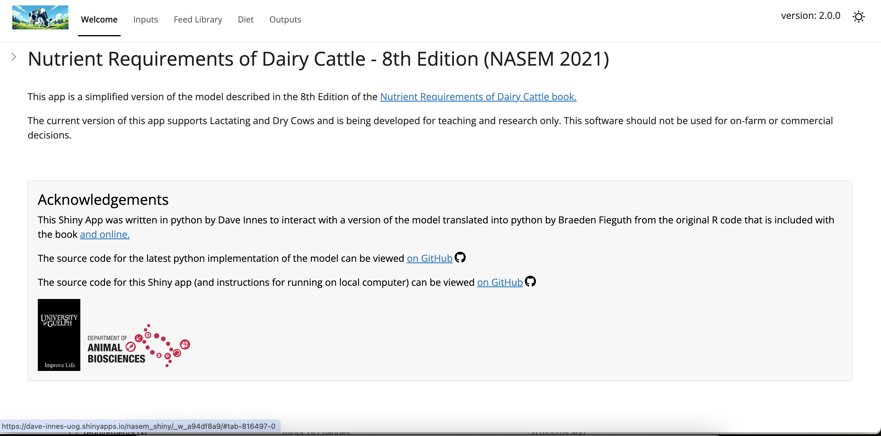
Welcome

Slide 13
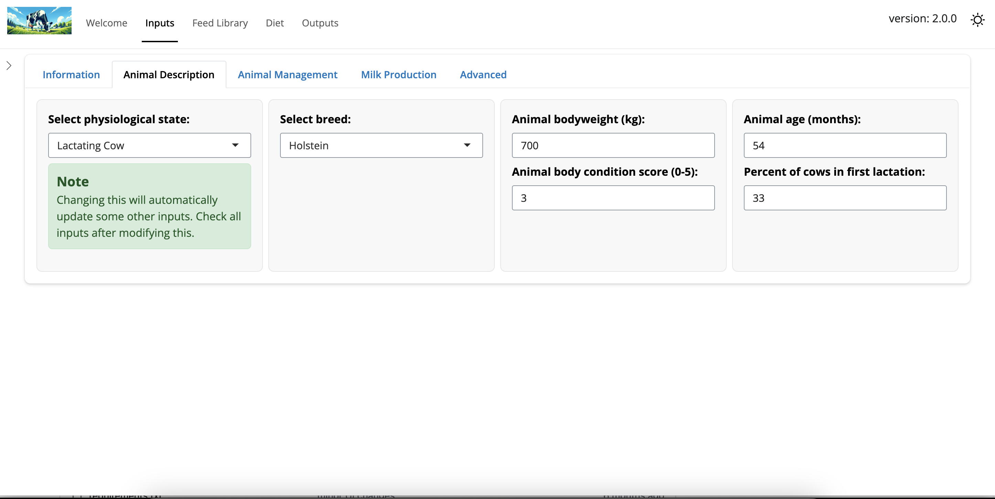
Inputs

Slide 14
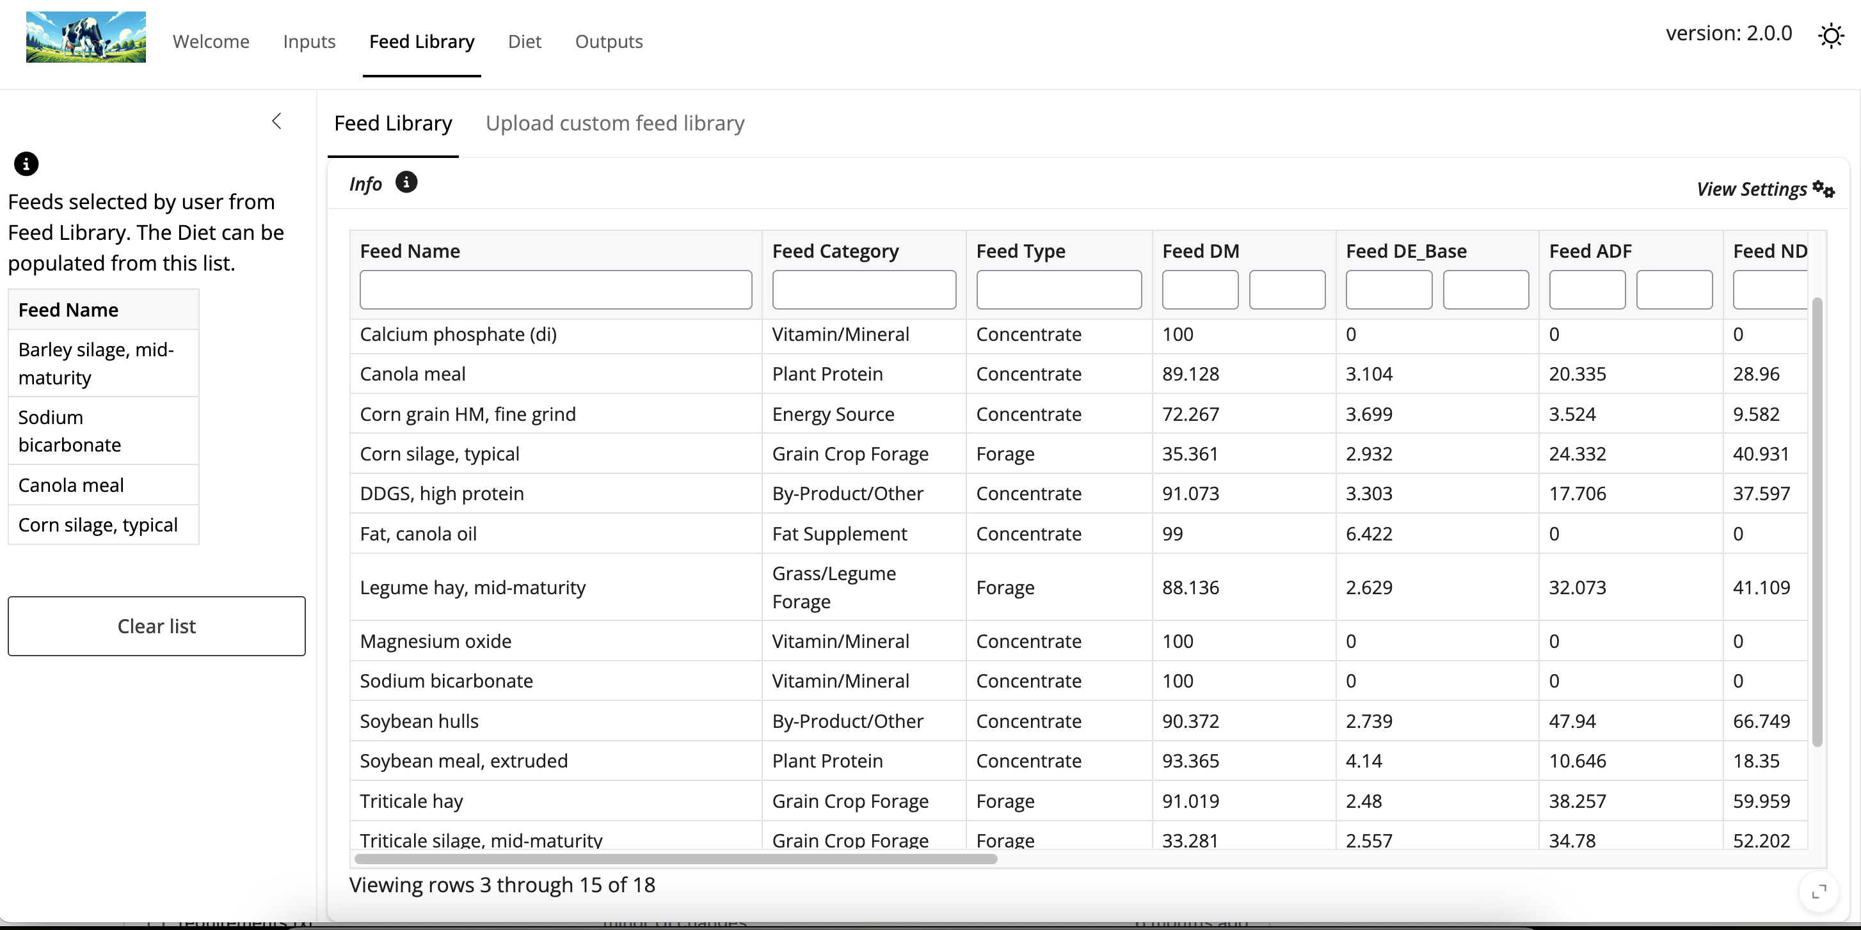
Feed Library

Slide 15
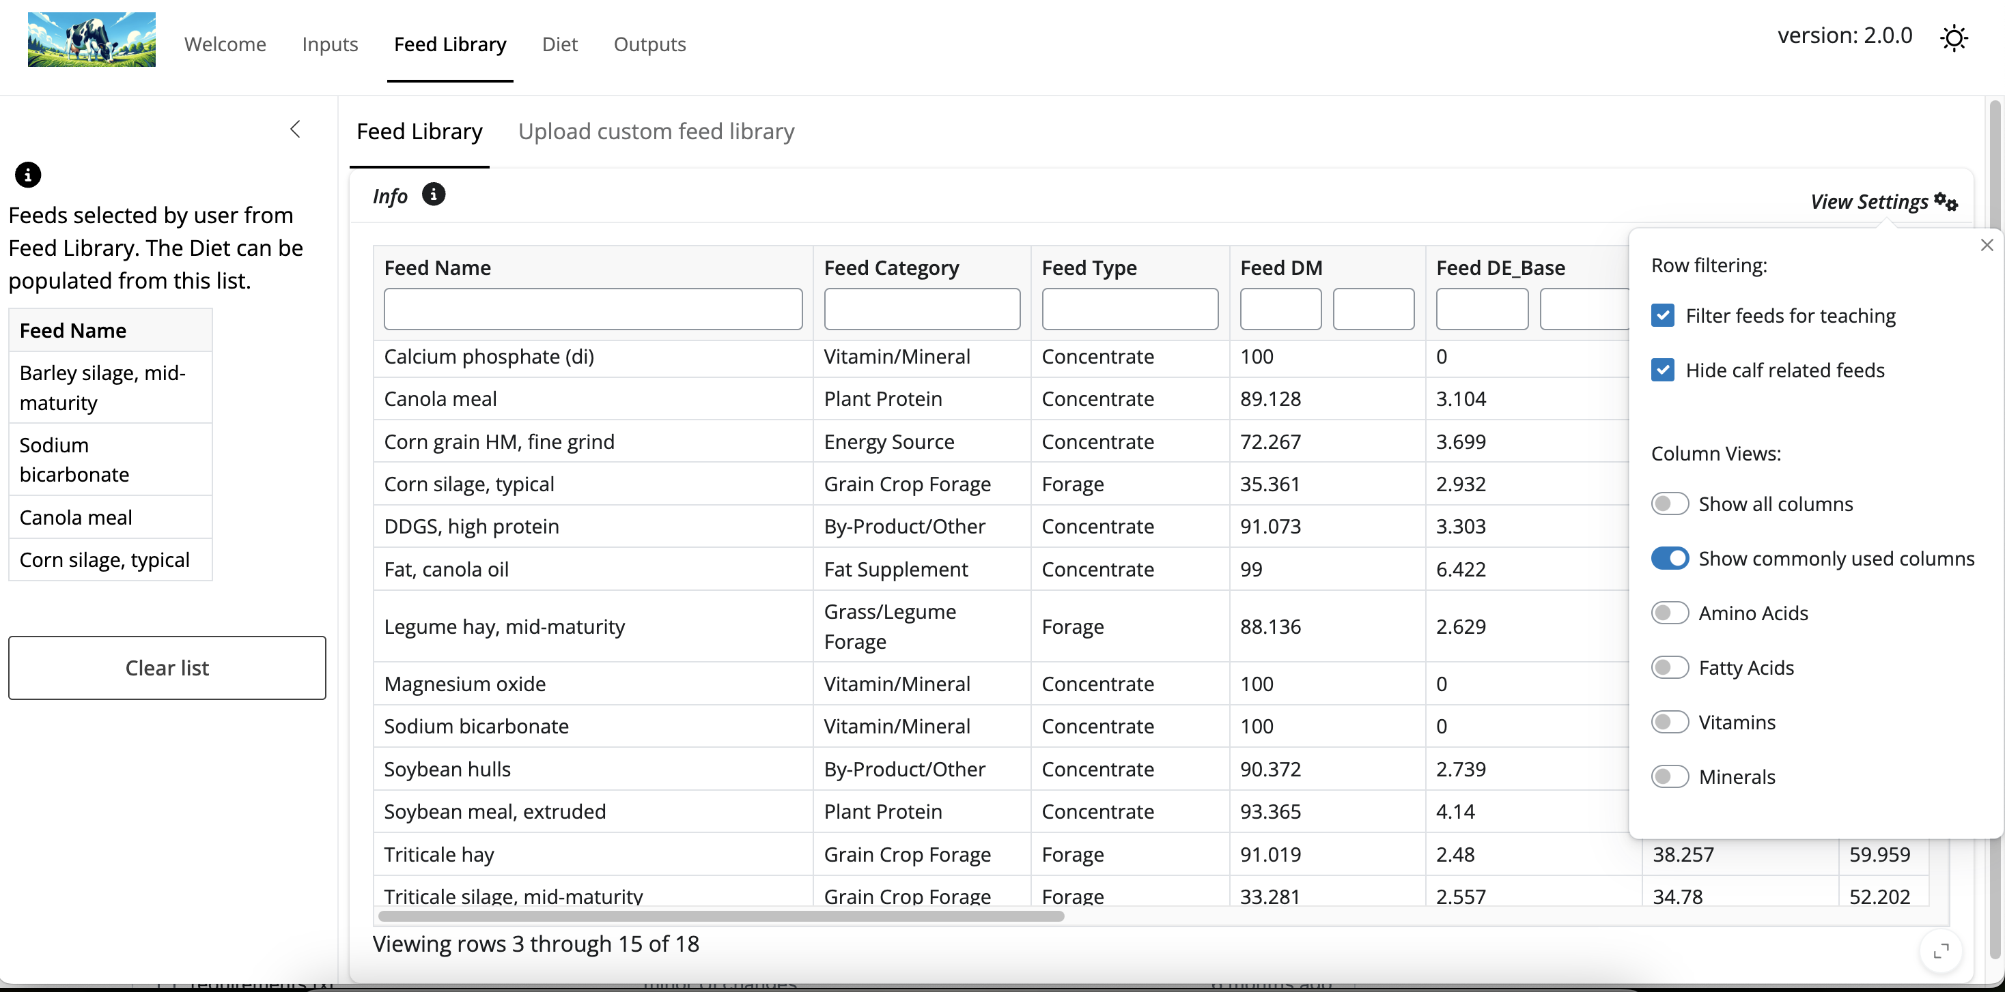
Feed Library - viewer settings

Slide 16
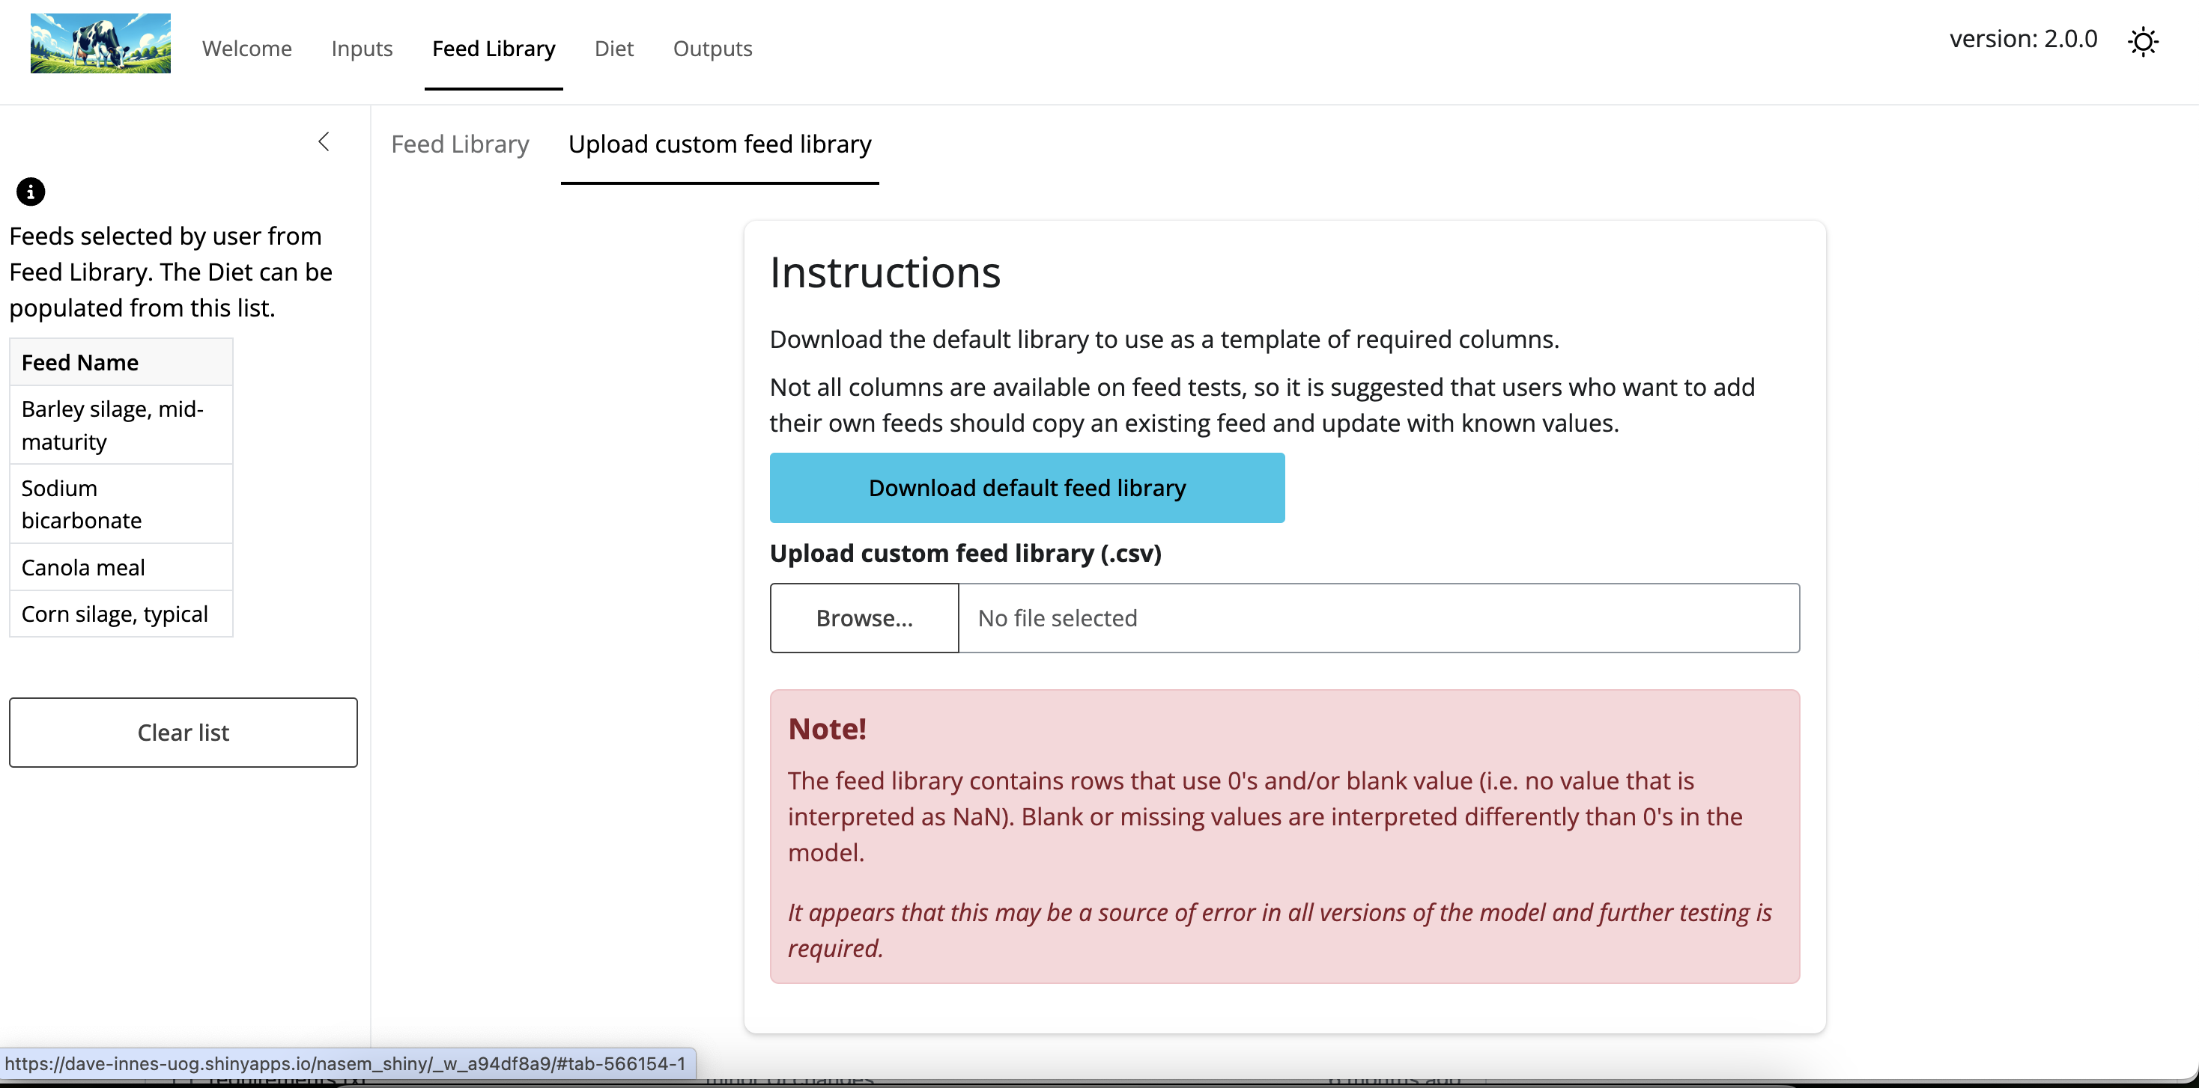
Upload custom feed library

Slide 17
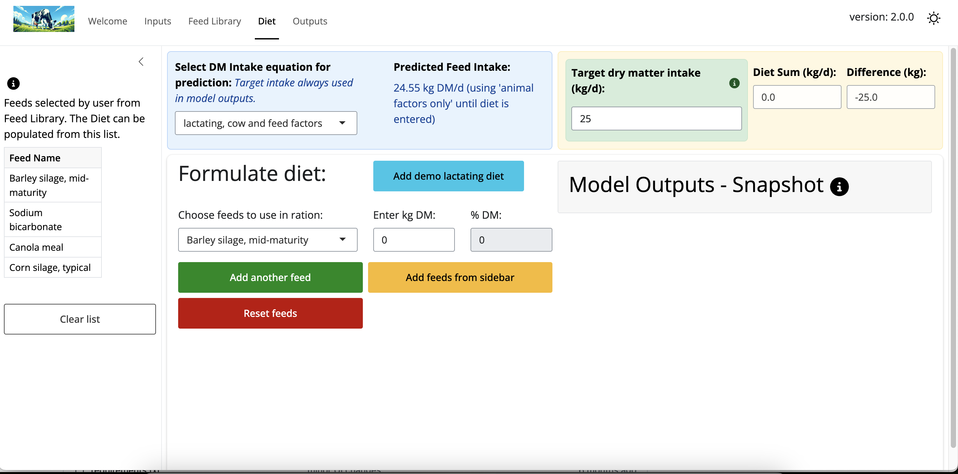
Diet Input

Slide 18
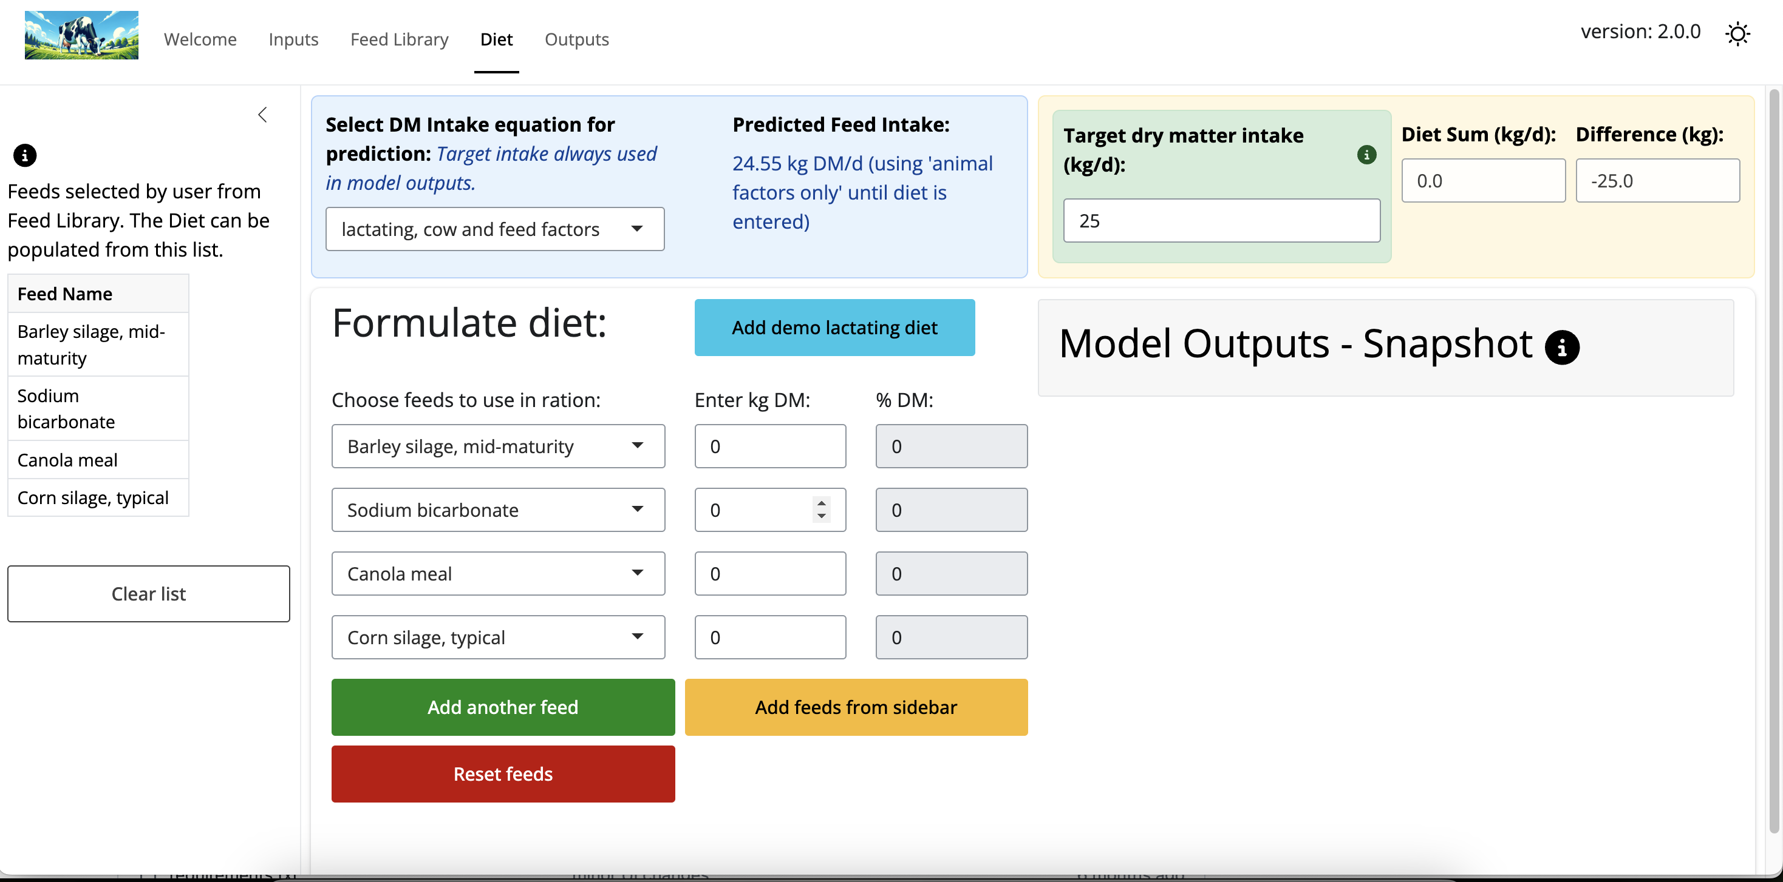
Diet Input - sidebar

Slide 19
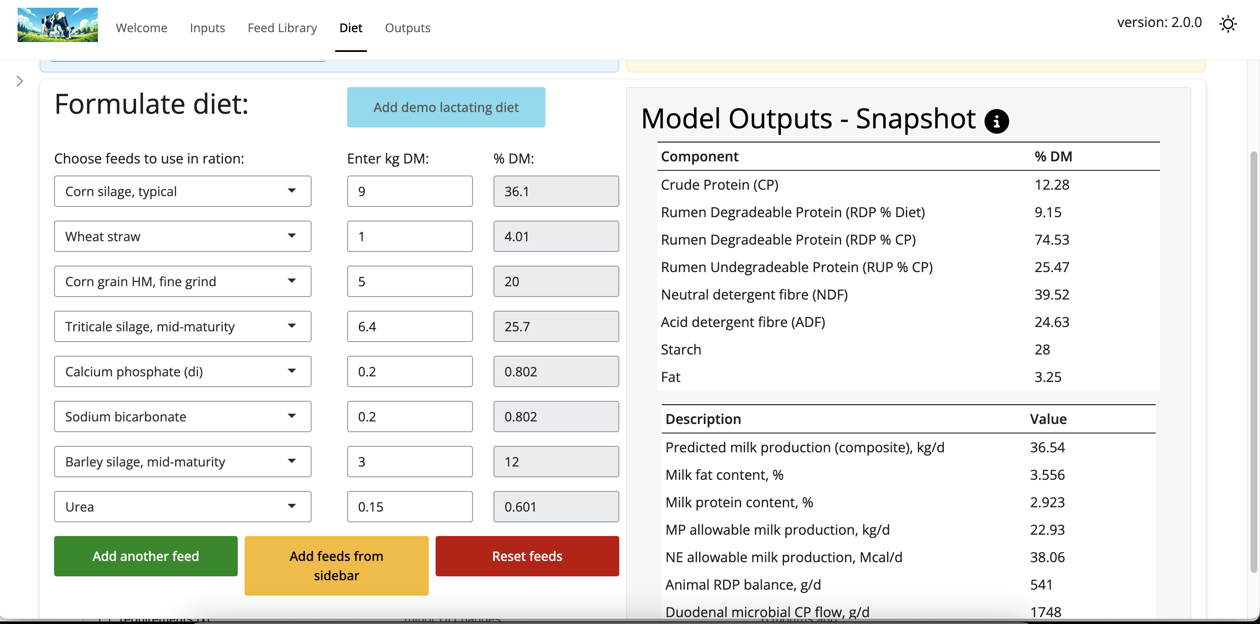
Built-in demo diet

Slide 20
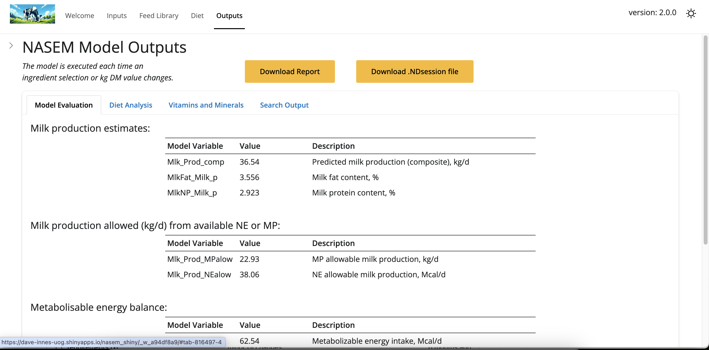
Outputs

Slide 21
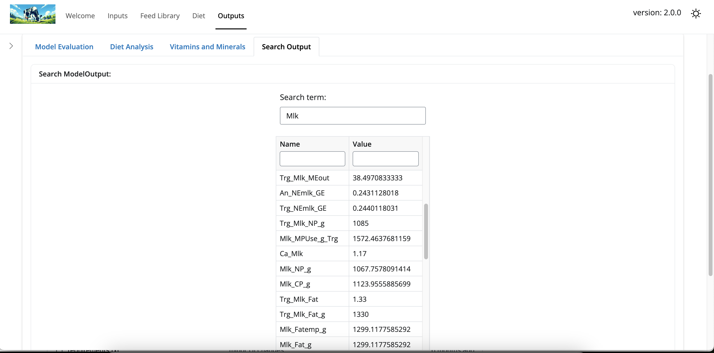
Advanced - search all model outputs

Slide 22
Assignments

Slide 23
Early Semester
Assignment sheet with steps and screen recordings
Demonstrations in workshops
Pre-loaded scenarios with a clear mistake
Mid Semester
Introduce Dry vs Lactating Cow
Read and interpret farm forage analyses
Adding forages as new ingredients
Formulating full diets

Slide 24
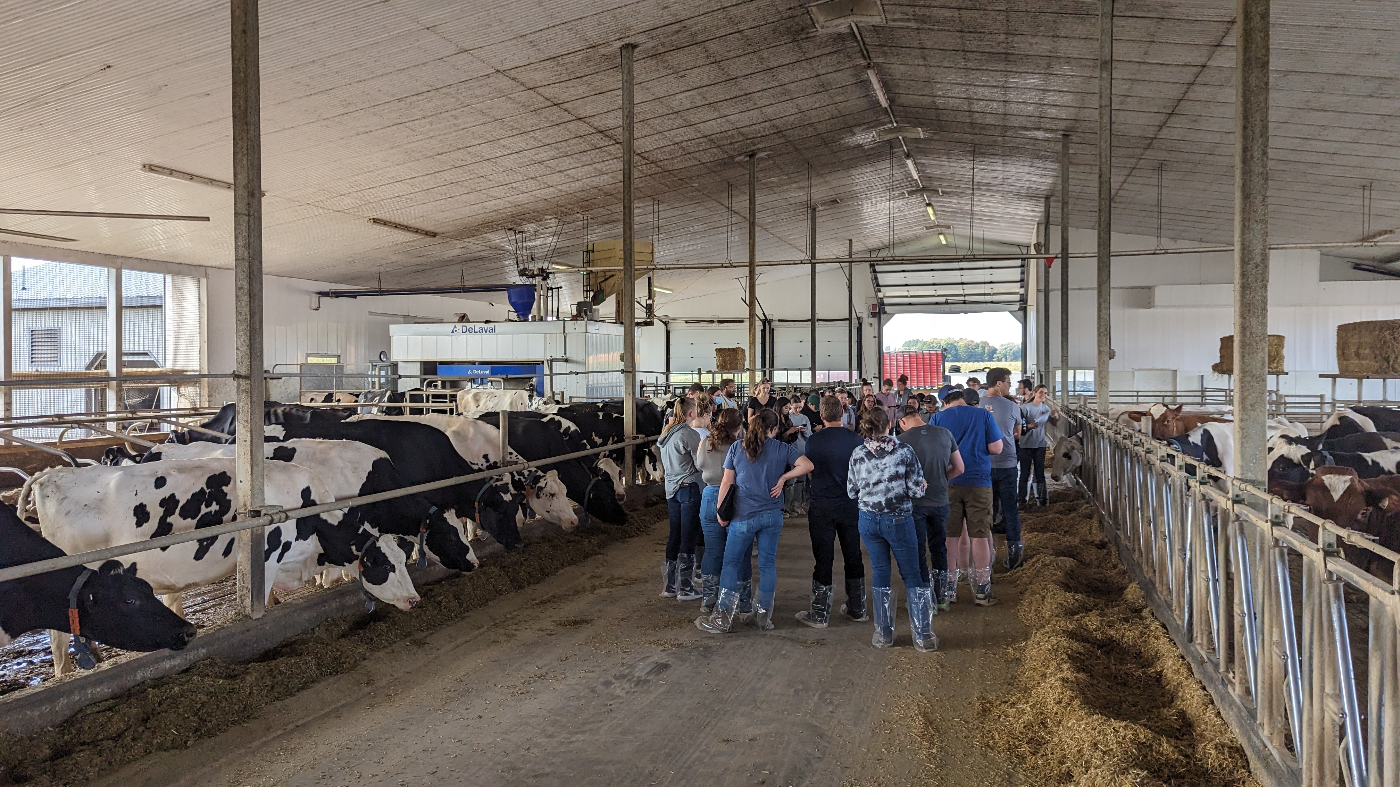
Case Study Assignment

Slide 25
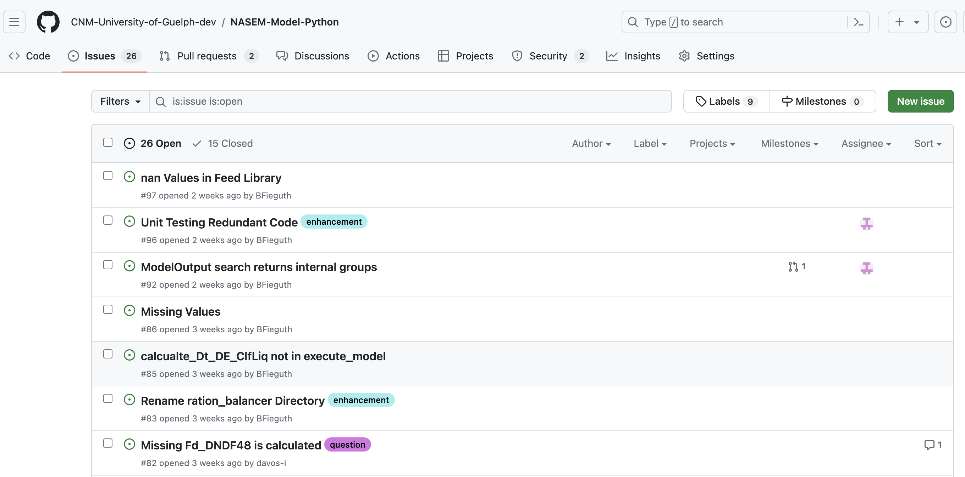
Initial feedback
Early versions couldn’t save sessions
Student’s needed multiple ways to learn it - videos, step-by-step instructions, classroom demo
They appreciated the user experience and not having to install anything
How to use & contribute?

Slide 26
Conclusions
Quarto is an example of how future publishing can look
Shiny has potential to modernise teaching and research communication
We need to encourage our societies and organising committees to allow these tools to be used in meetings
Collectively sharing resources via an open-source platform will accelerate model improvement
feedback wanted
Thank you!

